Slide 1

Propagation on Residuals and Rethinking
马佳明
2023.09.20
中国科学技术大学 大数据学院 数据智能实验室

Slide 2
Content
Few-Shot on Graph
Scenarios and Definition of Transductive Node Classification
Traditional Method for TNC
Propagation on Residuals
Rethinking about Future

Slide 3
1. Few-show on Graph

Slide 4
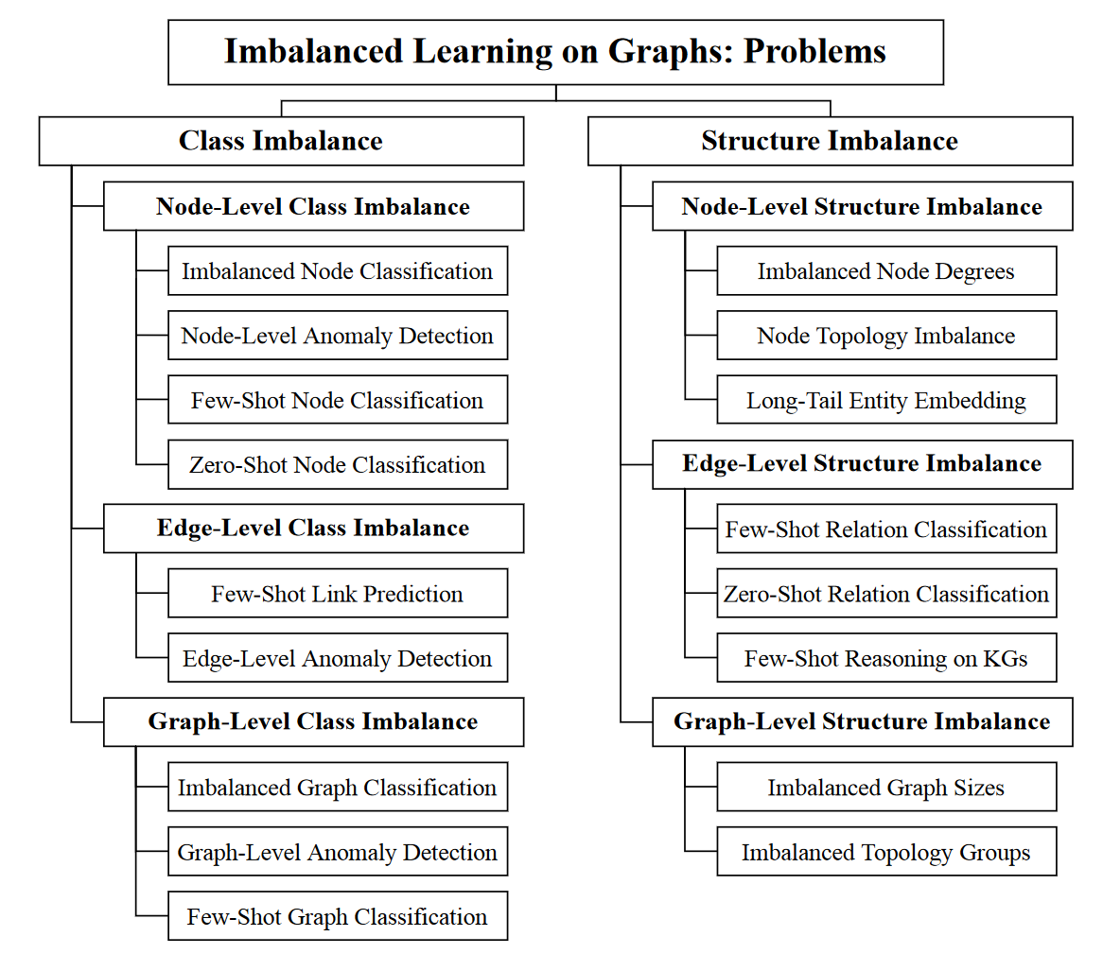
Few-shot on Graph？
Node Classification (Transductive)
Link Prediction
Graph Classification
Relation Classification
Reasoning on Knowledge-Graph
—— Deep Long-Tailed Learning: A Survey, Zhang & etc., PAMI 2023.
—— A Survey of Imbalanced Learning on Graphs: Problems, Techniques, and Future Directions, Liu & etc., arXiv 2023.
—— A Survey on Graph Neural Networks for Time Series: Forecasting, Classification, Imputation, and Anomaly Detection, Jin & etc., arXiv 2023.

Slide 5
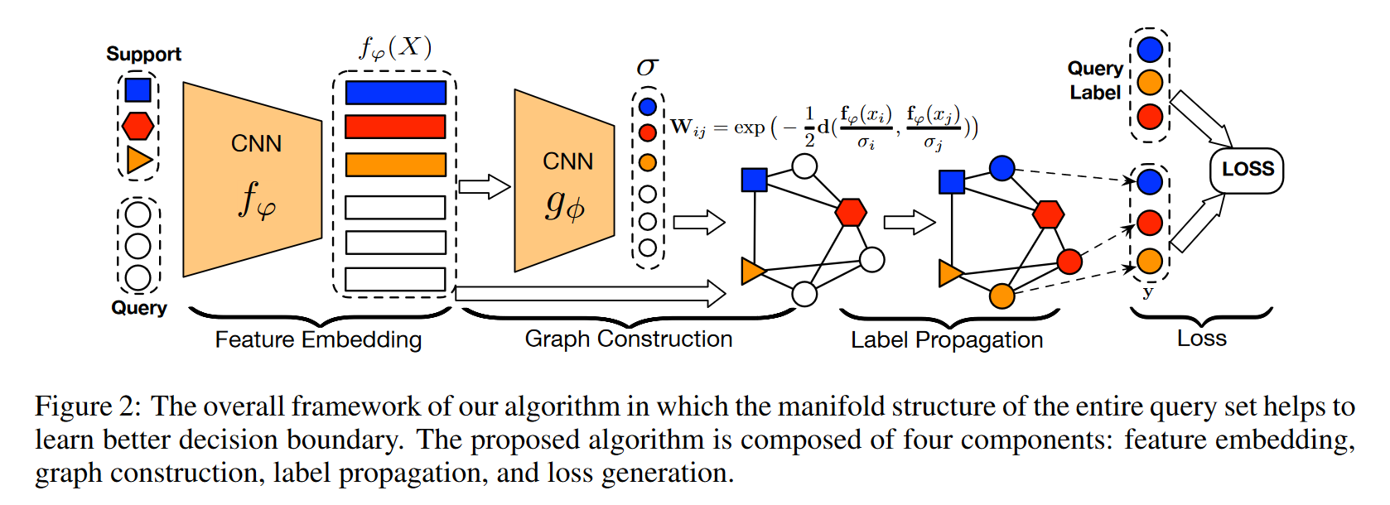
CV: 1st Transductive Inference Explicitly in Few-Shot Learning.
—— Learning to Propagate Labels: Transductive Propagation Network for Few-shot Learning. Liu & etc., ICLR 2019.

Slide 6
2. Scenarios and Definition on Transductive Node Classification

Slide 7
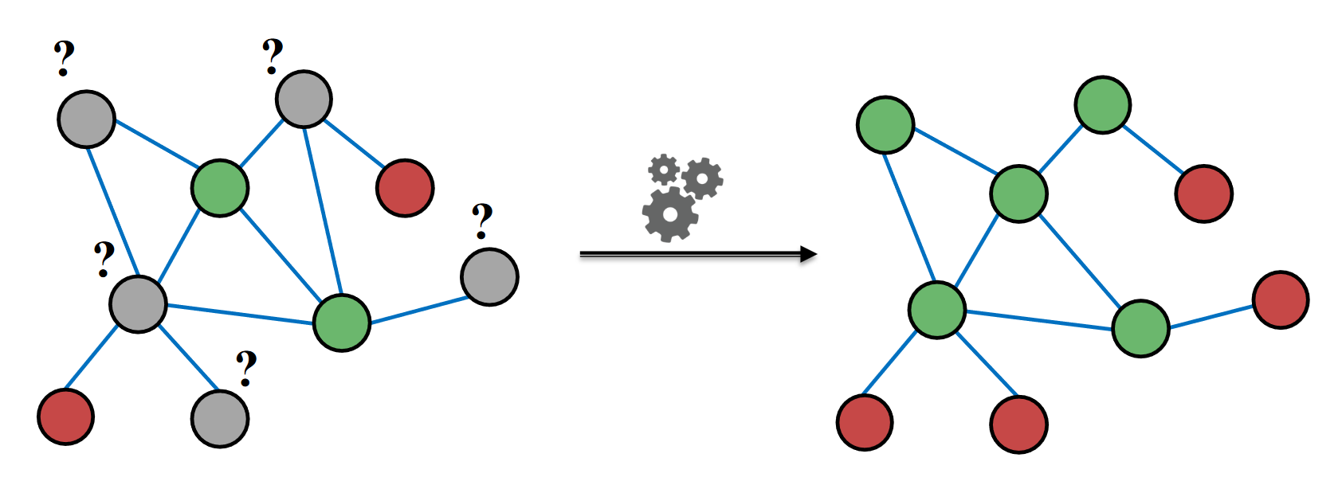
Scenarios: Transductive Node Classification
通过使用图上已知标记(Label)的节点，来预测图上未知标记的节点的标记。
仅关注于当前图中的节点，而不考虑将来可能出现的新节点。
Always Few-shot!
// Semi-supervised: 训练数据集中只有部分数据标记有标签，而大部分数据没有标签。目标是通过利用有标签数据和无标签数据的信息（feature），来进行模型训练和预测。
// Inductive: 通过使用已知标记的节点来构建一个模型，然后将该模型应用于未来出现的新节点。它更加关注于构建通用的模型，可以应用于未来的节点分类任务。（GraphSAGE）
—— Inductive Representation Learning on Large Graphs. Hamilton & etc., NIPS 2017.

Slide 8
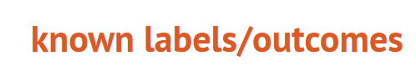
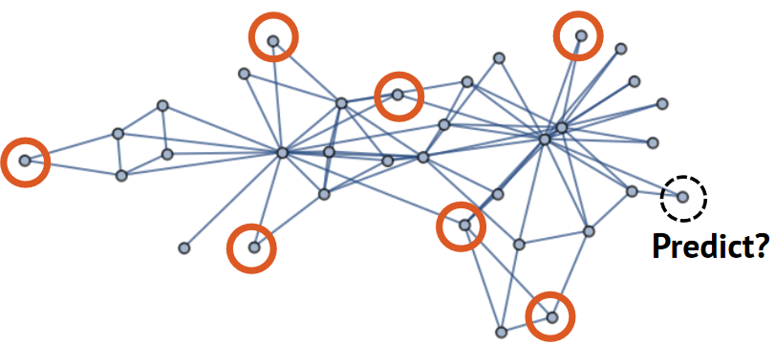
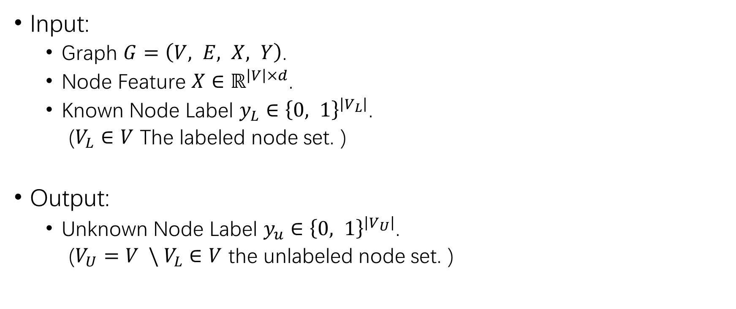
Naïve Definition
Input:
Graph $G=\left(V, E, X, Y\right)$.
Node Feature $X∈ℝ^{\left|V\right|×d}$.
Known Node Label $y_{L}∈{\left\{0, 1\right\}}^{\left|V_{L}\right|}$.
($V_{L}∈V$ The labeled node set. )
Output:
Unknown Node Label $y_{u}∈{\left\{0, 1\right\}}^{\left|V_{U}\right|}$.
($V_{U}=V \backslash V_{L}∈V$ the unlabeled node set. )

Slide 9
3. Traditional Method for TNC

Slide 10
1. Simplicial Label Propagation or GNNs.
—— Semi-Supervised Learning Using Gaussian Fields and Harmonic Functions. Zhu & etc., ICML 2003.

Slide 11

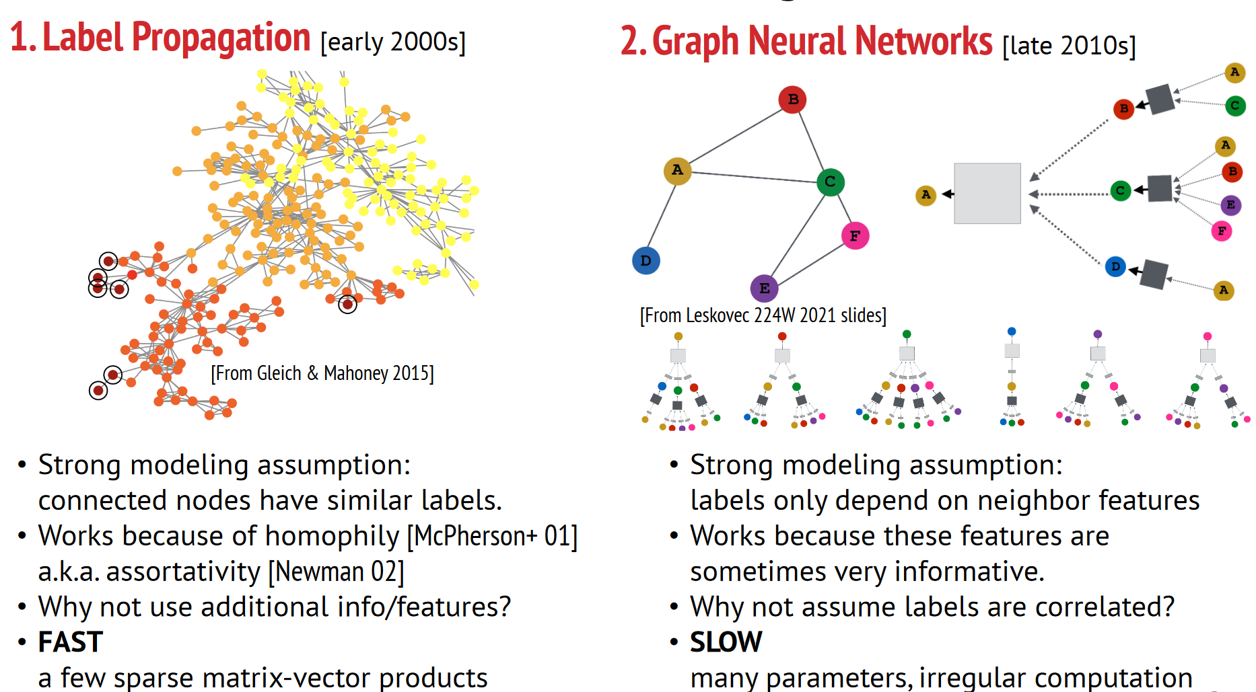
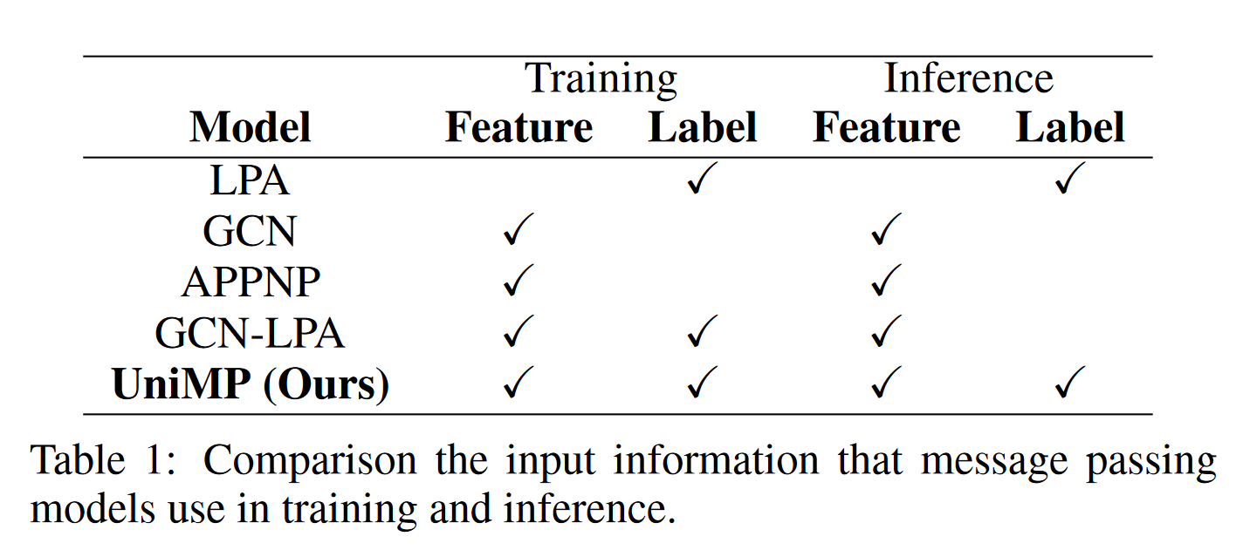
.
1. Simplicial Label Propagation or GNNs
LP assumptions:
1. Homophily
GNNs assumptions:
1. Labels only depend on neighbor features.
2. Features are informative.
Propagation ≈ Smoothness
—— Semi-Supervised Learning Using Gaussian Fields and Harmonic Functions. Zhu & etc., ICML 2003.

Slide 12
1. Simplicial Label Propagation or GNNs.
—— Semi-Supervised Learning Using Gaussian Fields and Harmonic Functions. Zhu & etc., ICML 2003.
2. GNNs + Propagation.
—— Predict then Propagate: Graph Neural Networks meet Personalized PageRank. Gasteiger & etc., ICLR 2019.
—— Unifying Graph Convolutional Neural Networks and Label Propagation. Wang & Leskovec., ariXiv 2020.

Slide 13
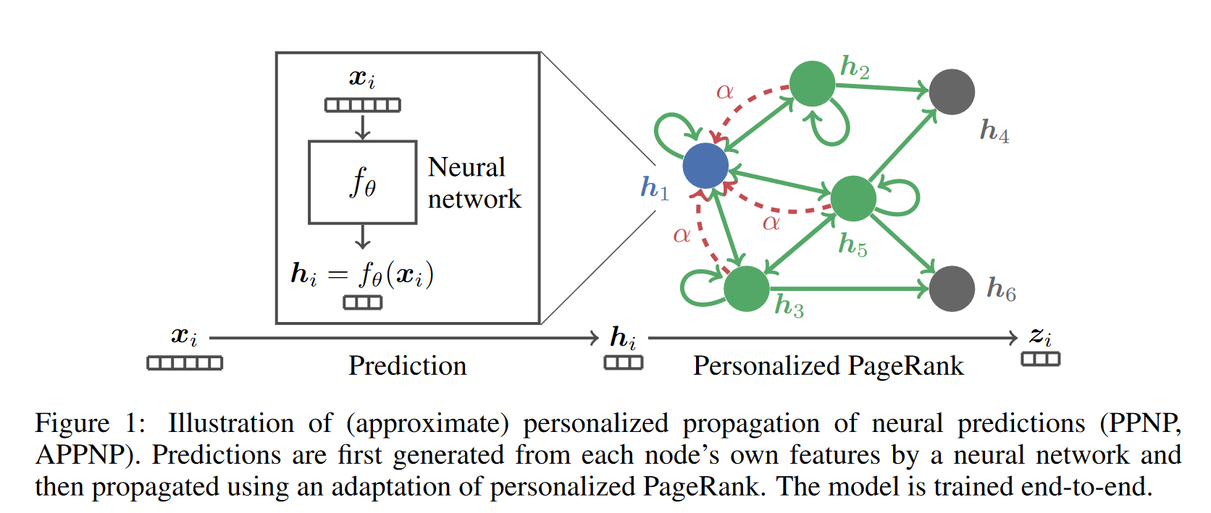
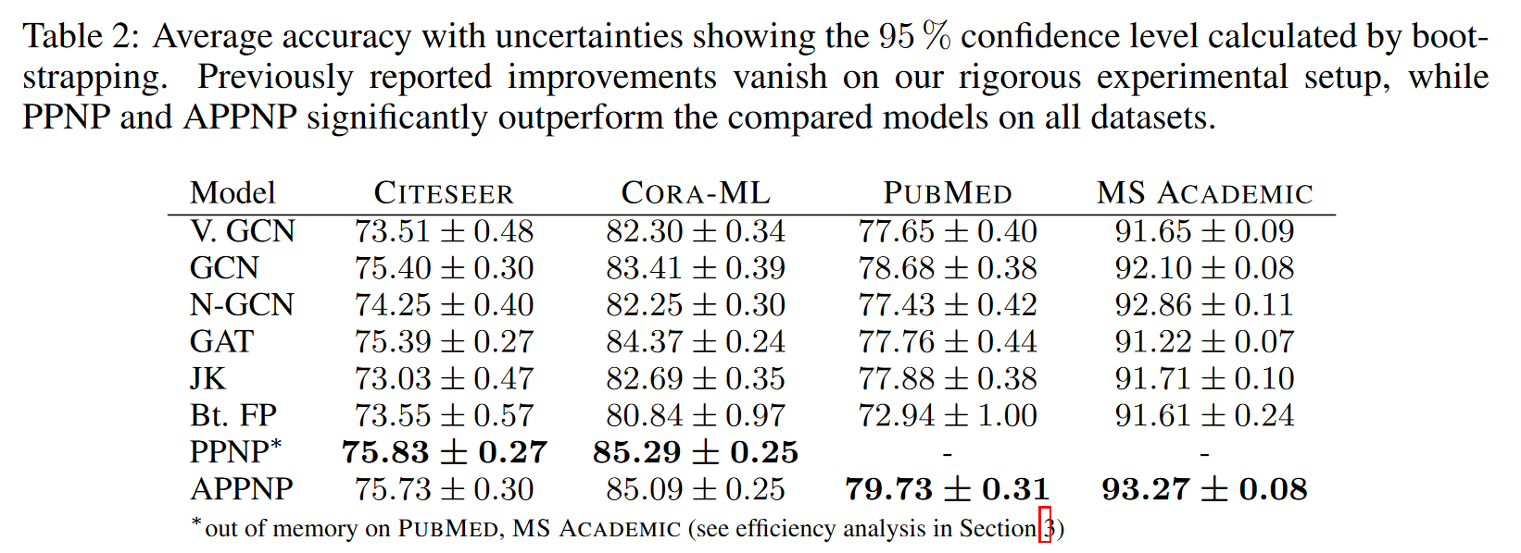
2. GNNs + Propagation
PPNP & APPNP:
GCN + PageRank :
1. Personalization
2. Approximation
3. Embedding Propagation
(≈ Feature Propagation)
—— Predict then Propagate: Graph Neural Networks meet Personalized PageRank. Gasteiger & etc., ICLR 2019.
—— The Anatomy of a Large-Scale Hypertextual Web Search Engine. Brin & Page, Computer networks and ISDN systems, 1998.

Slide 14
2. GNNs + Propagation
PPNP & APPNP:
GCN + PageRank :
1. Personalization
2. Approximation
3. Embedding Propagation (≈ Feature Propagation)
4. No labels utilized during training and inference.
5. Marginal improvement.
—— Predict then Propagate: Graph Neural Networks meet Personalized PageRank. Gasteiger & etc., ICLR 2019.
—— The Anatomy of a Large-Scale Hypertextual Web Search Engine. Brin & Page, Computer networks and ISDN systems, 1998.

Slide 15
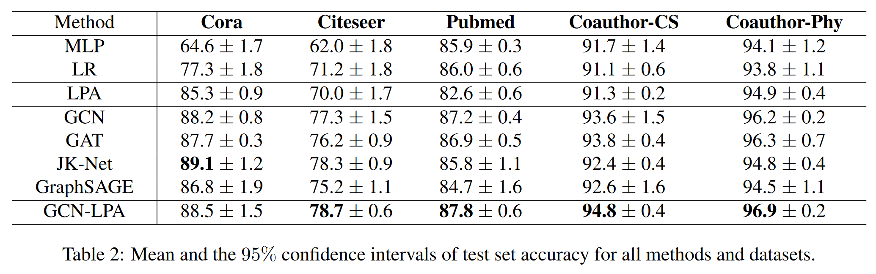
2. GNNs + Propagation
GCN-LPA:
GCN + LPA :
1. LPA during training weight.
2. Overemphasis to Label.
3. Depending on GNNs with trainable weight edge like GAT.
—— Unifying Graph Convolutional Neural Networks and Label Propagation. Wang & Leskovec., ariXiv 2020.
—— Graph Attention Networks. Velickovic & etc., ICLR 2018.

Slide 16
1. Simplicial Label Propagation or GNNs.
—— Semi-Supervised Learning Using Gaussian Fields and Harmonic Functions. Zhu & etc., ICML 2003.
2. GNNs + Propagation.
—— Predict then Propagate: Graph Neural Networks meet Personalized PageRank. Gasteiger & etc., ICLR 2019.
—— Unifying Graph Convolutional Neural Networks and Label Propagation. Wang & Leskovec., ariXiv 2020.
3. Not only Propagation on Feature but also done so on Label.
—— Masked Label Prediction: Unified Message Passing Model for Semi-Supervised Classification. Shi & etc., IJCAI 2021.

Slide 17
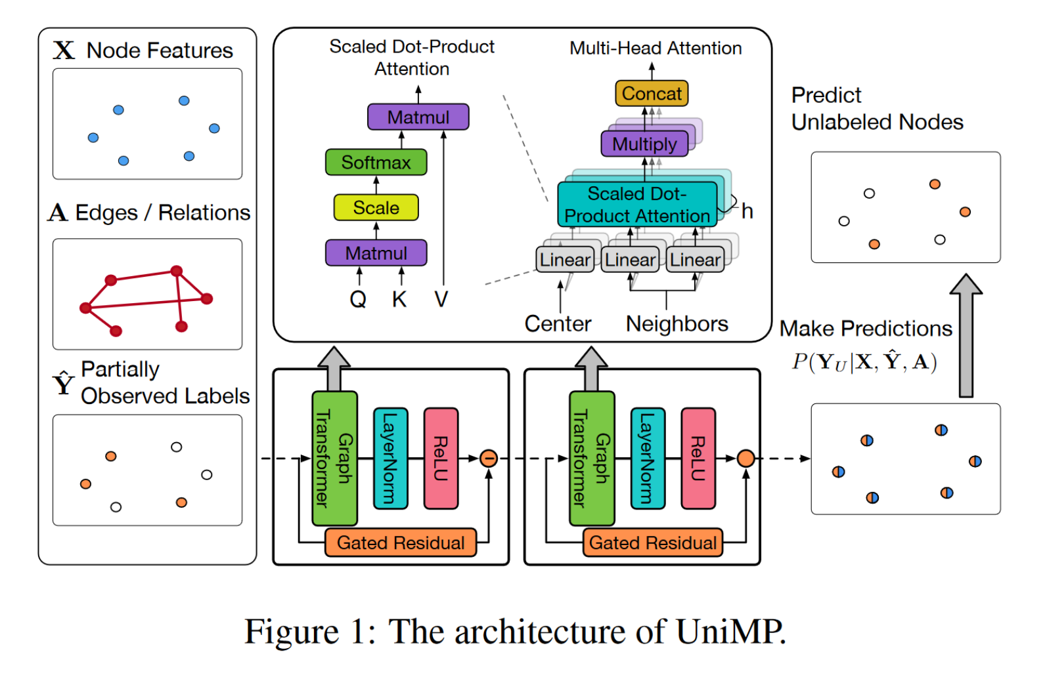
3. GNNs + L&F Propagation
UniMP:
GAT+ All Propagation:
1. L&F Propagation;
2. Masked Known Label.
—— Masked Label Prediction: Unified Message Passing Model for Semi-Supervised Classification. Shi & etc., IJCAI 2021.
—— Training Sparse Neural Networks. Srinivas& etc., CVPR Workshops, 2017.

Slide 18
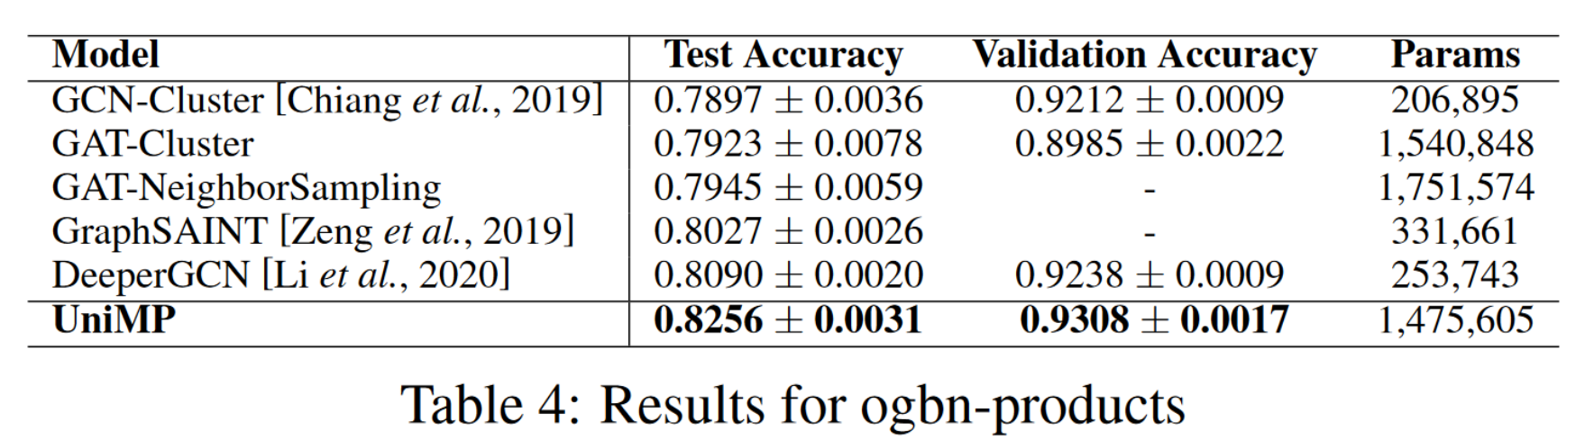
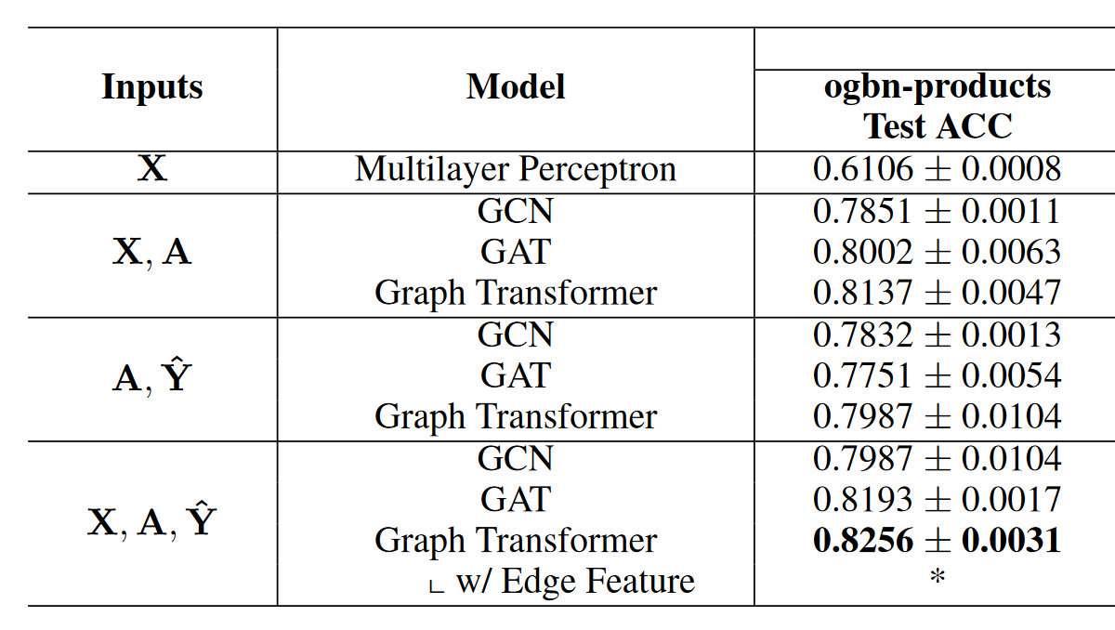
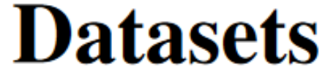
3. GNNs + L&F Propagation
UniMP:
GAT+ All Propagation:
1. L&F Propagation;
2. Masked Known Label.
SOTA ! (2022.09)
—— Masked Label Prediction: Unified Message Passing Model for Semi-Supervised Classification. Shi & etc., IJCAI 2021.
—— Training Sparse Neural Networks. Srinivas& etc., CVPR Workshops, 2017.

Slide 19
4. Propagation on Residuals

Slide 20
1. LP on residuals.
—— Residual Correlation in Graph Neural Network Regression. Jia & Benson, KDD 2020.

Slide 21
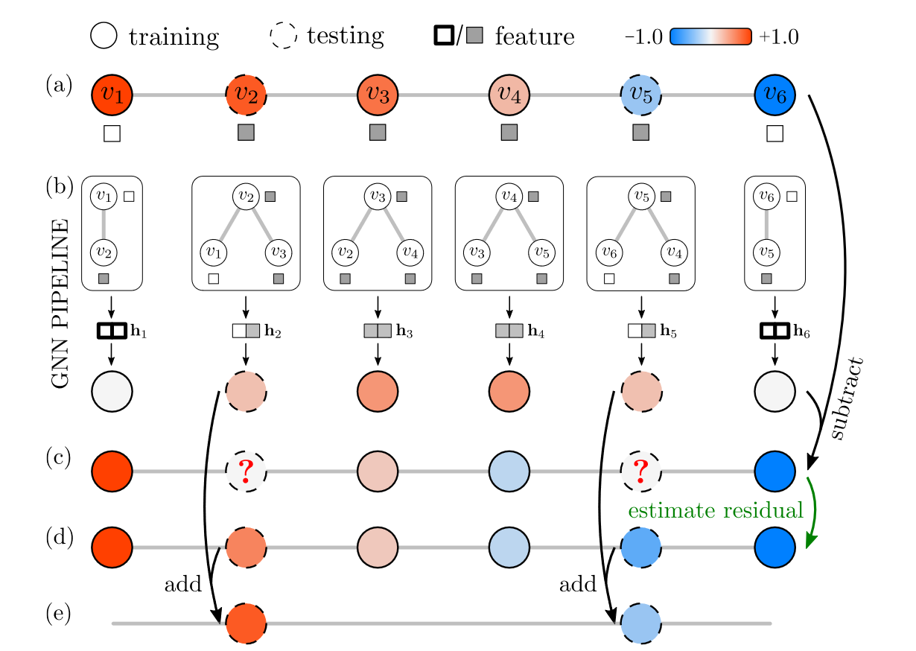


1. LP on residuals for improving GNN regression algorithms.
Claim: GNNs tend to generate biased predictions, resulting in residuals.
Reason: Labels and features are not necessarily strongly correlated.
—— Residual Correlation in Graph Neural Network Regression. Jia & Benson, KDD 2020.

Slide 22
1. LP on residuals for improving GNN regression algorithms.
Problem: LPA appended can not figure out this situation.
Reason: The pseudo-label distribution has changed.
—— Residual Correlation in Graph Neural Network Regression. Jia & Benson, KDD 2020.

Slide 23
1. LP on residuals for improving GNN regression algorithms.
Solution: Residual Propagation
Base prediction.
Residual Cal. on labeled nodes.
Residual propagation.
Final prediction
= smoothed residual + base prediction
(= true value on labeled nodes)
—— Residual Correlation in Graph Neural Network Regression. Jia & Benson, KDD 2020.

Slide 24
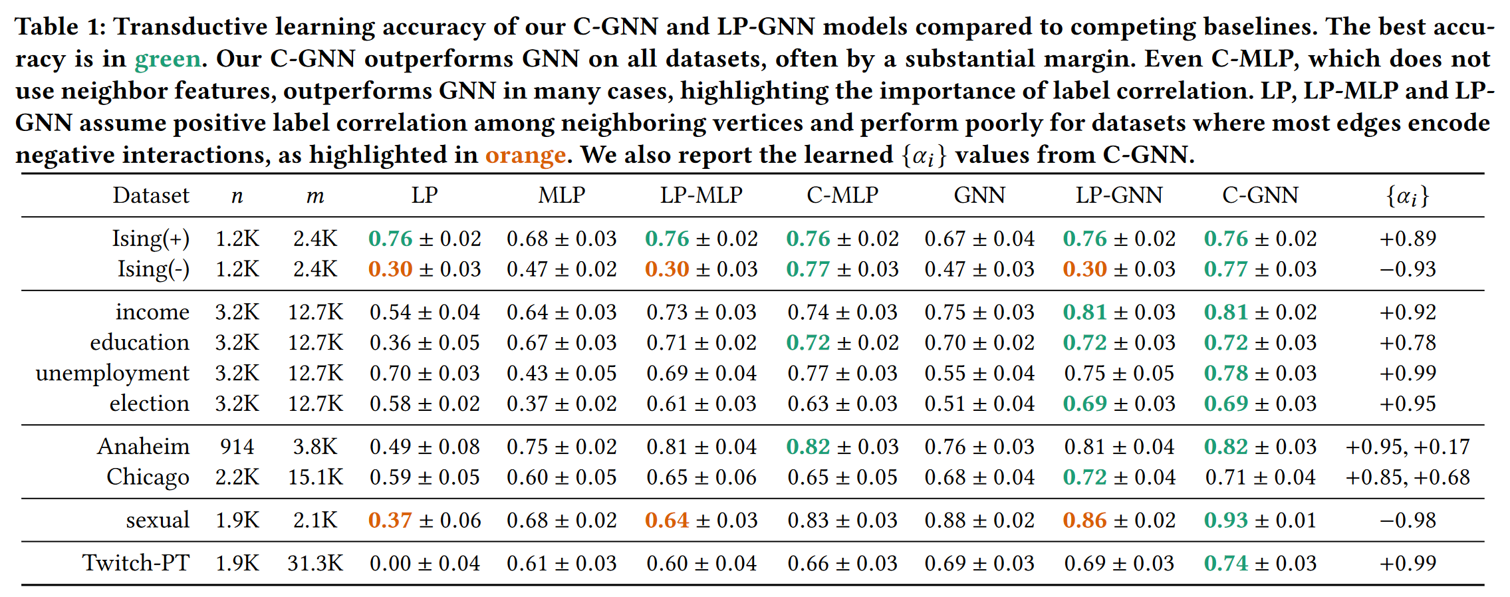
1. LP on residuals for improving GNN regression algorithms.
—— Residual Correlation in Graph Neural Network Regression. Jia & Benson, KDD 2020.

Slide 25
1. LP on residuals.
—— Residual Correlation in Graph Neural Network Regression. Jia & Benson, KDD 2020.
2. Using LP on residuals but removing GNNs altogether.
—— Combining Label Propagation and Simple Models Out-performs Graph Neural Networks. Huang et al., ICLR 2021.

Slide 26
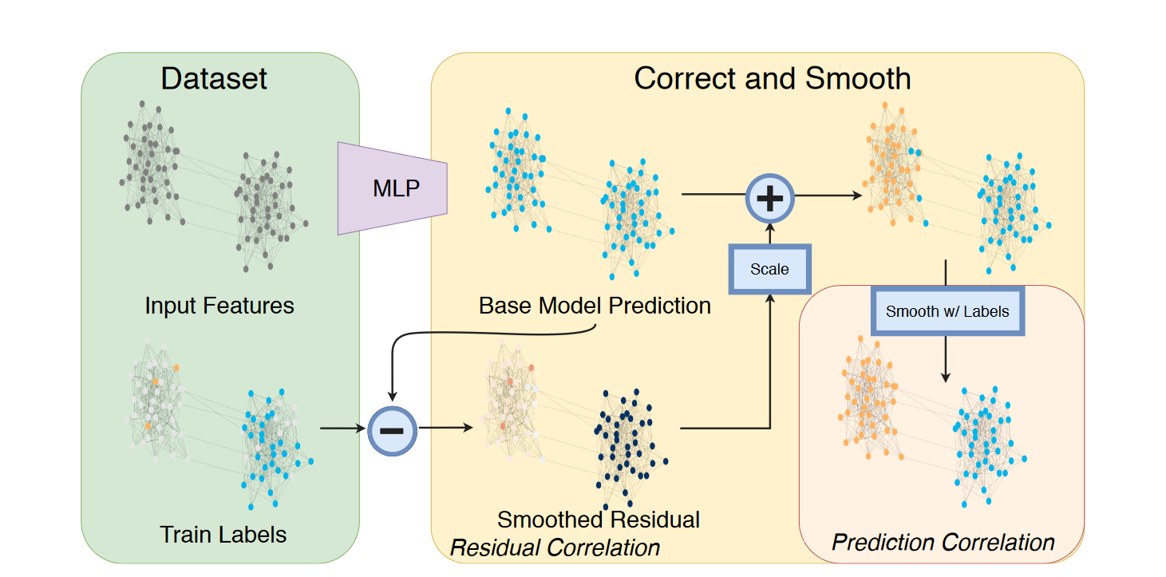
2. Using LP but removing GNNs altogether for good classification performance.
—— Combining Label Propagation and Simple Models Out-performs Graph Neural Networks. Huang et al., ICLR 2021.

Slide 27
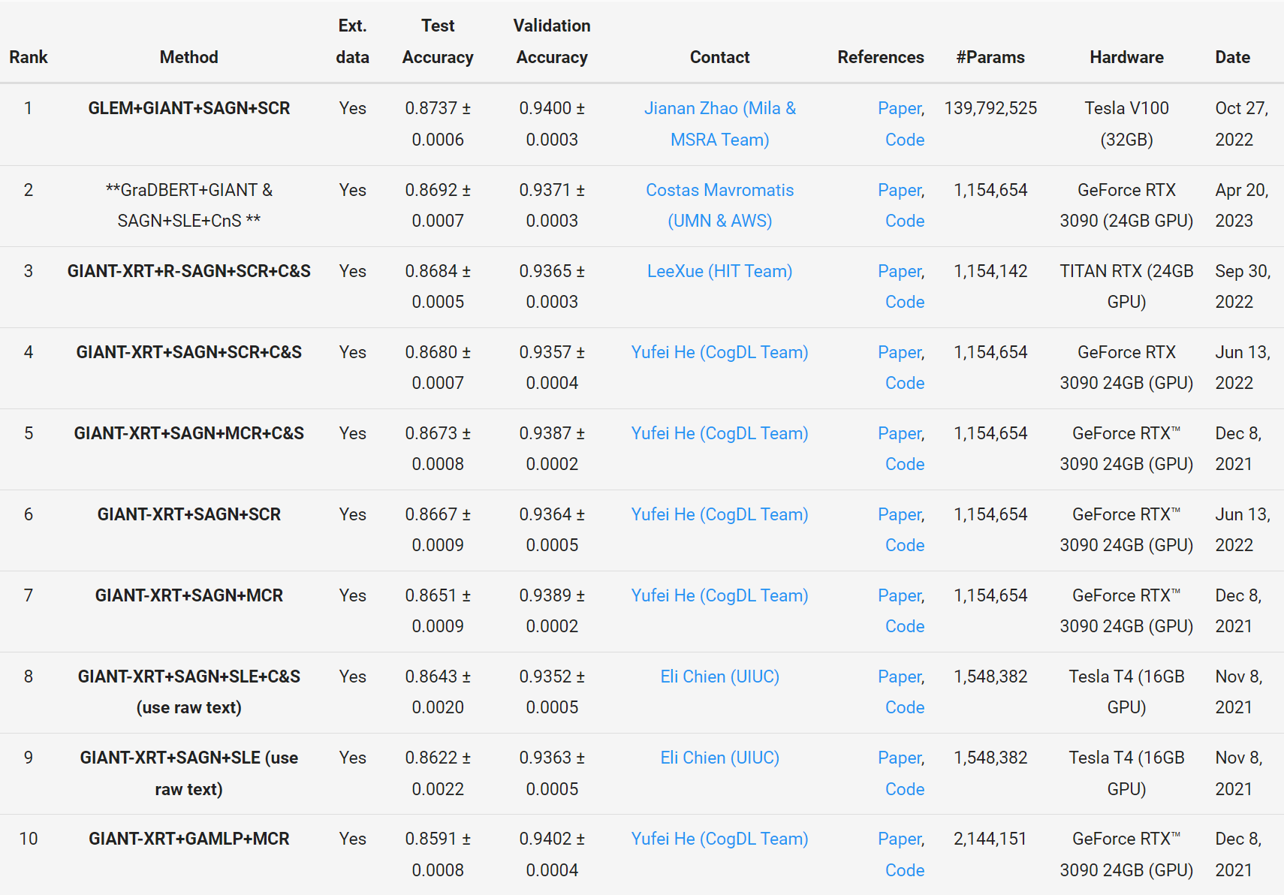
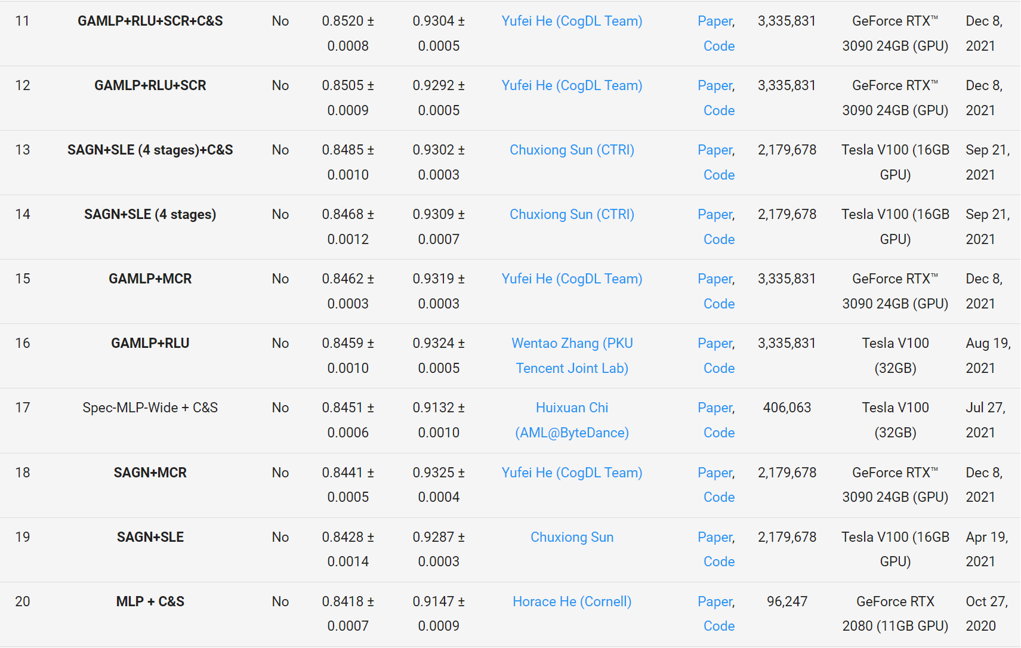
Leaderboard for ogbn-products.
——https://ogb.stanford.edu/docs/leader_nodeprop/
Amazon product co-purchasing network:
Undirected and unweighted;
Node: products sold in Amazon (# 2,449,029);
Edge: indicates the products are purchased together (# 61,859,140);
Node features: the product descriptions (PCA).
Prediction task:
Category of a product (# 47).
Methods related to C&S (up to now):
Top 5: 4/5 90%
Top 20: 9/20 45%

Slide 28
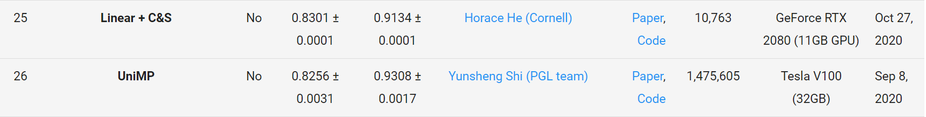
…
…
GAT (Neighbor sampling or Cluster) (+ C&S)
…
GraphSAGE (+ C&S)
…
…
Node2vec
…

Slide 29
1. LP on residuals.
—— Residual Correlation in Graph Neural Network Regression. Jia & Benson, KDD 2020.
2. Using LP on residuals but removing GNNs altogether.
—— Combining Label Propagation and Simple Models Out-performs Graph Neural Networks. Huang et al., ICLR 2021.
3. Statistical framework that unifies LP and GNN ideas.
—— A Unifying Generative Model for Graph Learning Algorithms: Label Propagation, Graph Convolutions, and Combinations. Jia & Benson, SIAM Journal on Mathematics of Data Science 2022.

Slide 30
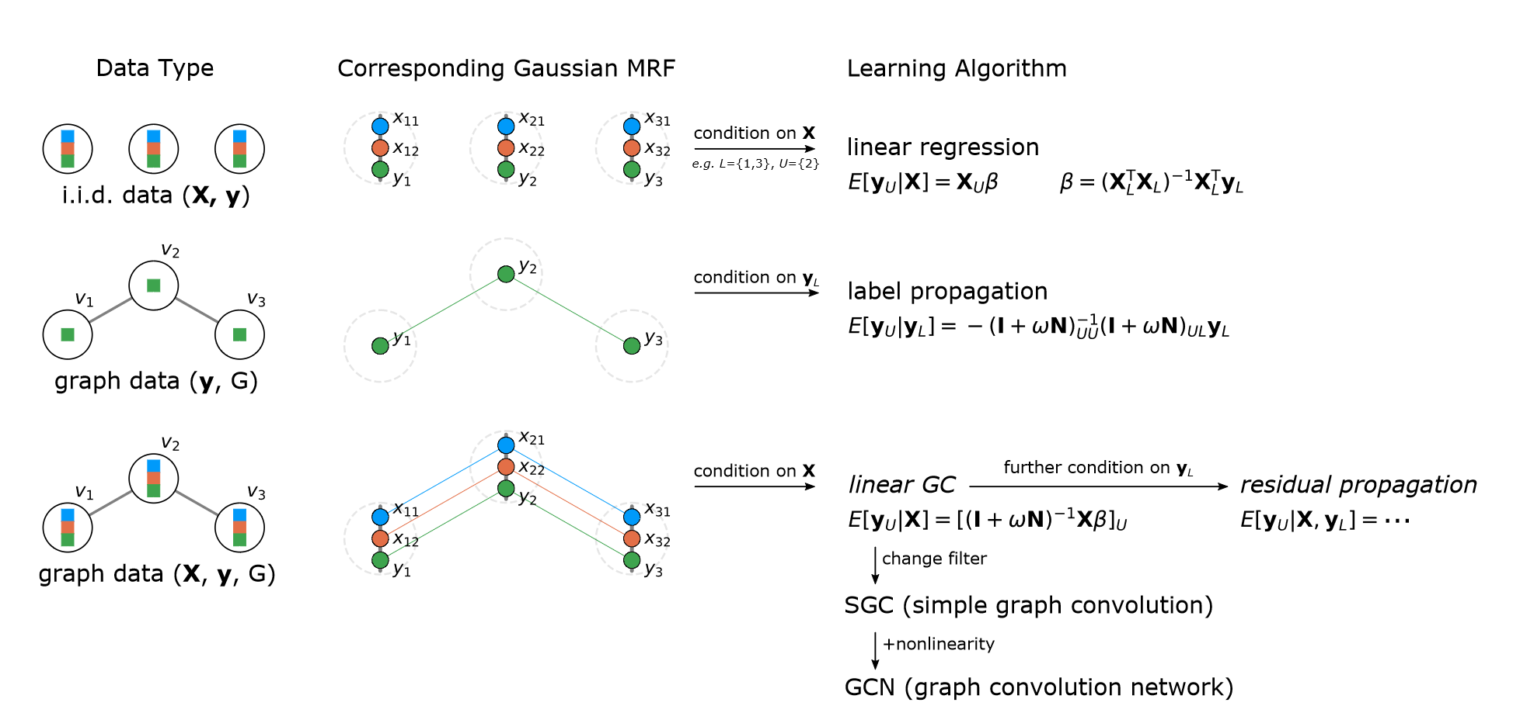
3. Statistical framework that unifies LP and GNN ideas.
—— A Unifying Generative Model for Graph Learning Algorithms: Label Propagation, Graph Convolutions, and Combinations. Jia & Benson, SIAM Journal on Mathematics of Data Science 2022.

Slide 31
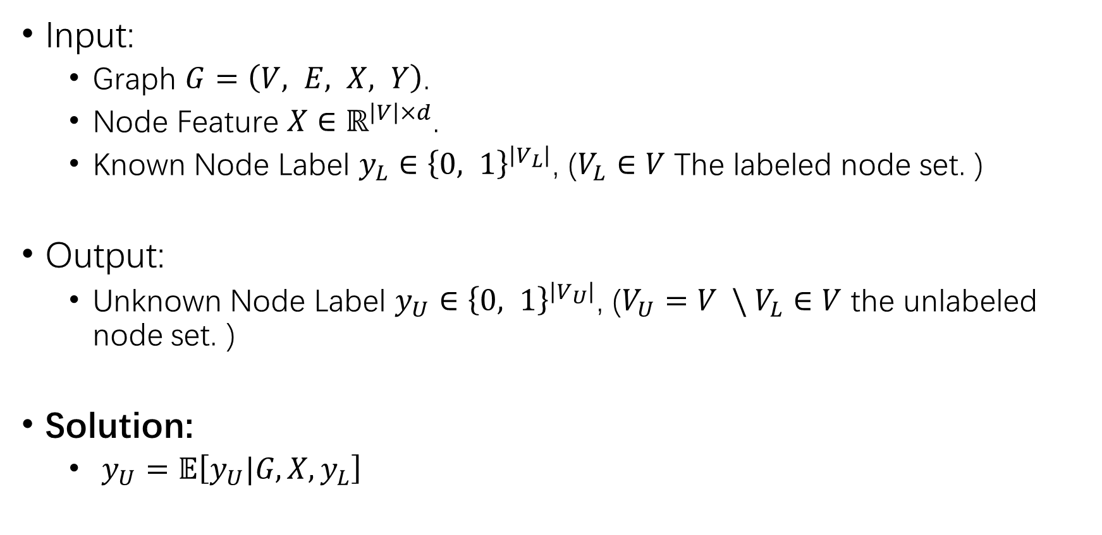
3. Statistical framework that unifies LP and GNN ideas.
Input:
Graph $G=\left(V, E, X, Y\right)$.
Node Feature $X∈ℝ^{\left|V\right|×d}$.
Known Node Label $y_{L}∈{\left\{0, 1\right\}}^{\left|V_{L}\right|}$, ($V_{L}∈V$ The labeled node set. )
Output:
Unknown Node Label $y_{U}∈{\left\{0, 1\right\}}^{\left|V_{U}\right|}$, ($V_{U}=V \backslash V_{L}∈V$ the unlabeled node set. )
Solution:
$y_{U}=𝔼\left[y_{U}|G, X, y_{L}\right]$
—— A Unifying Generative Model for Graph Learning Algorithms: Label Propagation, Graph Convolutions, and Combinations. Jia & Benson, SIAM Journal on Mathematics of Data Science 2022.

Slide 32
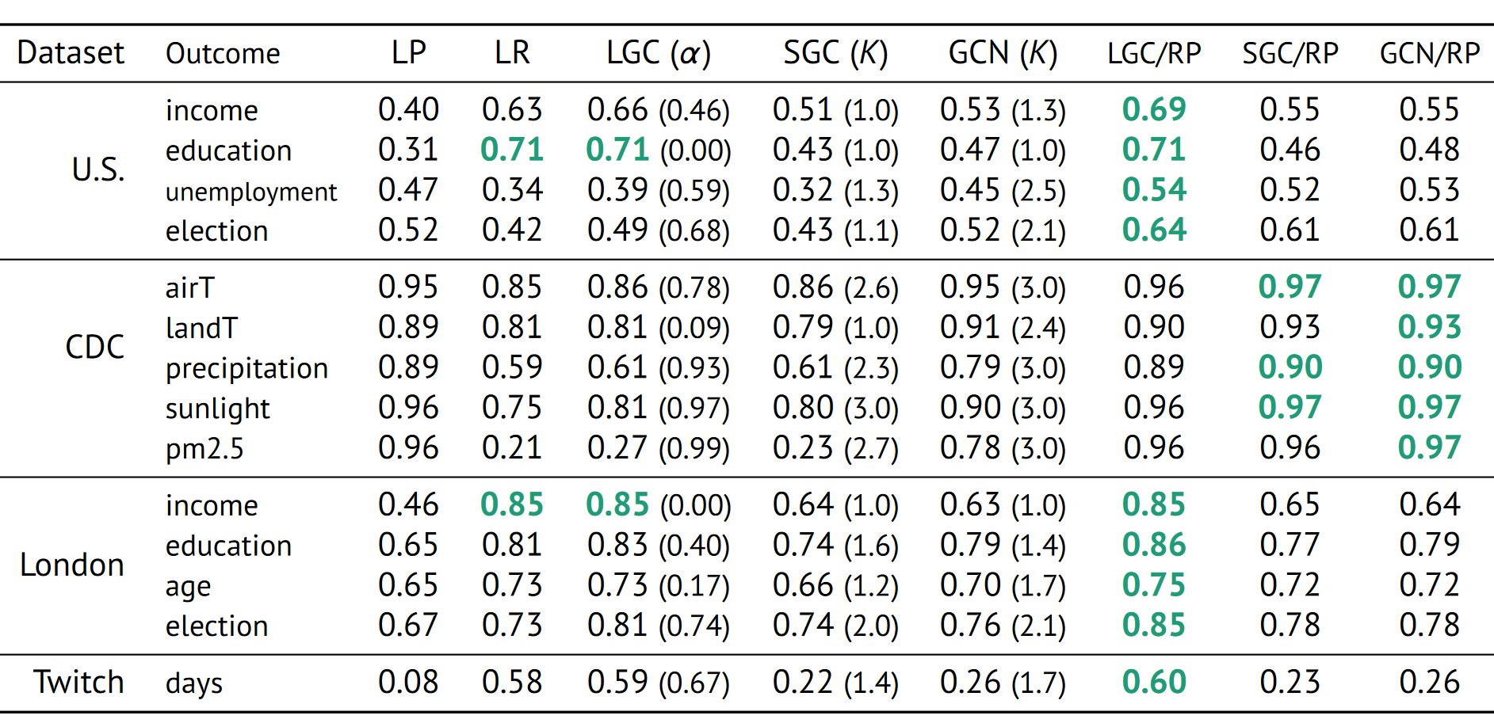
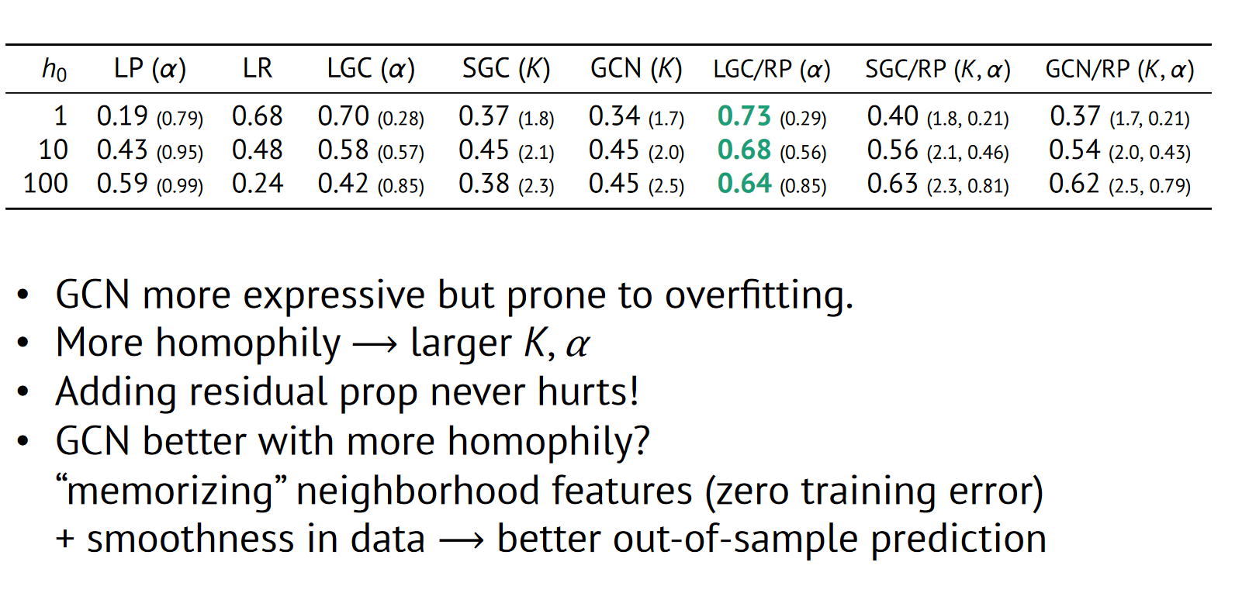
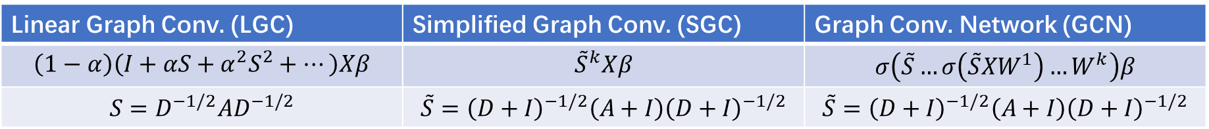
3. Statistical framework that unifies LP and GNN ideas.
Linear Graph Conv. (LGC) | Simplified Graph Conv. (SGC) | Graph Conv. Network (GCN)
$$\left(1−α\right)\left(I+αS+α^{2}S^{2}+…\right)Xβ$$ | $${\tilde{S}}^{k}Xβ$$ | $$σ\left(\tilde{S}…σ\left(\tilde{S}XW^{1}\right)…W^{k}\right)β$$
$$S=D^{−1/2}AD^{−1/2}$$ | $$\tilde{S}={\left(D+I\right)}^{−1/2}\left(A+I\right){\left(D+I\right)}^{−1/2}$$ | $$\tilde{S}={\left(D+I\right)}^{−1/2}\left(A+I\right){\left(D+I\right)}^{−1/2}$$
—— A Unifying Generative Model for Graph Learning Algorithms: Label Propagation, Graph Convolutions, and Combinations. Jia & Benson, SIAM Journal on Mathematics of Data Science 2022.
—— Graph Signal Processing: Overview, Challenges and Applications. Ortega & etc., Proceedings of the IEEE 2018.

Slide 33
5. Rethinking about Future

Slide 34
LP is a powerful tool:
Applied to residuals (correlated errors), features (smoothing / de-noising), final predictions (more smoothness)
Linear models are often superior to nonlinear ones (GNNs) in TNC.

Slide 35
Few-shot on Graph:
Even nothing holds meaning.
Even a lack can suffice.

Slide 36
Feature？Label？
Feature: attribute we use.
Label: attribute we predict.

Slide 37
Residual?
Explicitness: What we need to correct.
Implicitness: Influence we have modeled.

Slide 38
Transductive？Inductive？
Learning the influence of the lack component in the Few-shot Problem.
Latent law.

Slide 39
Reference
[1] Deep Long-Tailed Learning: A Survey, Zhang & etc., PAMI 2023.
[2] A Survey of Imbalanced Learning on Graphs: Problems, Techniques, and Future Directions, Liu & etc., arXiv 2023.
[3] A Survey on Graph Neural Networks for Time Series: Forecasting, Classification, Imputation, and Anomaly Detection, Jin & etc., arXiv 2023.
[4] Learning to Propagate Labels: Transductive Propagation Network for Few-shot Learning. Liu & etc., ICLR 2019.
[5] Inductive Representation Learning on Large Graphs. Hamilton & etc., NIPS 2017.
[6] Semi-Supervised Learning Using Gaussian Fields and Harmonic Functions. Zhu & etc., ICML 2003.
[7] Predict then Propagate: Graph Neural Networks meet Personalized PageRank. Gasteiger & etc., ICLR 2019.
[8] The Anatomy of a Large-Scale Hypertextual Web Search Engine. Brin & Page, Computer networks and ISDN systems, 1998.
[9] Unifying Graph Convolutional Neural Networks and Label Propagation. Wang & Leskovec., ariXiv 2020.
[10] Graph Attention Networks. Velickovic & etc., ICLR 2018.
[11] Masked Label Prediction: Unified Message Passing Model for Semi-Supervised Classification. Shi & etc., IJCAI 2021.
[12] Training Sparse Neural Networks. Srinivas& etc., CVPR Workshops, 2017.
[13] Residual Correlation in Graph Neural Network Regression. Jia & Benson, KDD 2020.
[14] Combining Label Propagation and Simple Models Out-performs Graph Neural Networks. Huang et al., ICLR 2021.
[15] A Unifying Generative Model for Graph Learning Algorithms: Label Propagation, Graph Convolutions, and Combinations. Jia & Benson, SIAM Journal on Mathematics of Data Science 2022.
[16] Graph Signal Processing: Overview, Challenges and Applications. Ortega & etc., Proceedings of the IEEE 2018.
[17] Stanford CS224W: Label propagation on graph, Leskovec, http://web.stanford.edu/class/cs224w/slides/08-message.pdf.
[18] Label Propagation and Graph Neural Networks, Benson & etc., https://www.cs.cornell.edu/~arb/slides/2021-03-12-northeastern.pdf.

Slide 40
Thx for Q&A : )

